Slide 1
Software Engineering
Chapter 2
Software Process (Life Cycle)
Learning Outcomes
Appreciate the need for a defined software process
Be able to describe in detail the main software process models
Be able to compare software process models and choose between them
Understand software process improvement and maturity
Know about alternative approaches – agile and reengineering
Text: Priestley Chapter One and Chapter Three
Bruegge & Dutoit Chapter Fifteen and Chapter Sixteen

Slide 2
Model
Represent the software process you used on your last programming assignment.
artefact
activity
sequence
output /input

Slide 3
Primitive software process model
Represent the software process you used on your last programming assignment.
artefact
activity
sequence
output /input
Analyse Requirements
Write Code
Verdict: For a simple program written by one person, this works fine!
Requirements Specification
Source Code

Slide 4
Process
Suppose the last software process needed two programmers working together

Slide 5
More complex software process model
Analyse Requirements
Design Module Structure
Write Code
Requirements Specification
Structure Chart
Source Code

Slide 6



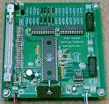
Exercise: describe the generic engineering process
Generic – building any product

Slide 7
Generic engineering process
Generic – building any product
Specification - set out requirements and constraints
Design - Produce a paper model of the system
Manufacture - build the system
Test - check the system meets the required specifications
Install - deliver system to customer and ensure it is operational
Maintain - repair faults in the system as they are discovered

Slide 8
Software Process - Who is involved?

Slide 9
Software Process - Who is involved?

Slide 10
Object Model of Software Process Activities

Slide 11
Software process models
Waterfall model
Separate and distinct phases of specification and development
Spiral Model and...
Incremental and Iterative Models
Specification and development are interleaved
Various versions
Agile Methods
Formal transformation
A mathematical system model is formally transformed to an implementation
Reuse-based development
The system is assembled from existing components

Slide 12
Waterfall model
Requirements Definition
Design
Implementation
Verification & Validation
Installation
Operation & Maintenance

Slide 13
Problems with the Waterfall Model?
?

Slide 14
Problems with the Waterfall Model?
Managers love waterfall models:
Nice milestones
No need to look back (linear system), one activity at a time
Easy to check progress : 90% coded, 20% tested
But, most software development is iterative
During design, problems with requirements are identified
During coding, design and requirement problems are found
During testing, coding, design& requirement errors are found
System development is a nonlinear activity
Often have to revisit and rework previous tasks
Verification and Validation (Testing) comes too late (very risky!)

Slide 15
Evolutionary Strategies
Main purpose of software process model is “to give risk-reducing structure” [Ould, 1990].
Growing recognition that in many cases software should be developed in an evolutionary fashion [e.g. McConnell, 1993]
e.g. Microsoft Visual C++ is shipped every 4 months
Agile Methods (more later) are all evolutionary
Software is “grown” rather than “built”
Ould, M.A., Strategies for Software Engineering: The Management of Risk and Quality, John Wiley, NY, 1990.
McConnell, S., Rapid Development: Taming Wild Software Schedules, Microsoft Press, Redmond, WA, 1996

Slide 16
Evolutionary models
Waterfall is poor at managing risk
Waterfall assumes that all requirements can be obtained upfront
Prototyping could provide the answer
Throwaway prototyping = building a prototype just to test a hypothesis.
In Extreme Programming this is known as a spike. Then build the real product.
Evolutionary Prototyping – build a prototype as a demonstrator, then use it as a base to build the full functionality
Prototyping particularly common in designing GUI’s
Lower risk since testing is very early! Risk is spread out.
Difficulties?

Slide 17
Evolutionary models
Waterfall is poor at managing risk
Waterfall assumes that all requirements can be obtained upfront
Prototyping could provide the answer
Throwaway prototyping = building a prototype just to test a hypothesis.
In Extreme Programming this is known as a spike. Then build the real product.
Evolutionary Prototyping – build a prototype as a demonstrator, then use it as a base to build the full functionality
Prototyping particularly common in designing GUI’s
Lower risk since testing is very early! Risk is spread out.
Difficulties?
Planning
Managers don’t like it
No guarantee that the end will be reached
Architecture could get messy – need for rework

Slide 18
Spiral Model (Boehm 1987)
*
Note: This is an example of how the spiral model might work
* = start

Slide 19
Spiral Model
1
Determine objectives, alternatives, constraints
2
Evaluate alternatives, identify and resolve risks
4
Plan Next Phase
Develop & verify next level product
3
cost
time

Slide 20
Spiral Model – risk
To understand the spiral model we need to understand risk
Risk = the possibility that some loss is incurred
Risk Exposure (RE) = probability * loss
Risk Analysis
Risk Identification
Risk Assessment (RE)
Risk Prioritisation = ranking
Risk Resolution = accept it OR reduce it OR avoid it
Risk Monitoring = where a risk is accepted watching possible triggers that might cause the risk

Slide 21
Spiral Model
The spiral model is an iterative model with the following activities:
Determine objectives, alternatives and constraints (1st quadrant)
Evaluate Alternatives (2nd quadrant)
Identify risks (2nd quadrant)
Resolve risks (2nd quadrant)
If a certain risk cannot be resolved satisfactorily, terminate the project (2nd quadrant)
Develop a series of prototypes for the identified risks starting with the highest risk. (2nd quadrant)
Aim is to make sure the highest risks are dealt with
Use a waterfall model (incremental may also be appropriate) for each next-level product development (3rd quadrant)
Evaluate the results of the “cycle” and plan the next round (4th quadrant)

Slide 22
Iterative and Incremental Development (IID)* What, how, why?
Interation 1
Iteration 1
Set of Requirements
Interation 2
Iteration 2
Interation 3
Iteration 3
Why is this good?
*of which the Spiral Model is an example
Notes:
Match with iCORE focus areas.
Pervasive character of software

Slide 23
Iterative and Incremental Development (IID) What, how, why?
Interation 1
Iteration 1
Set of Requirements
Interation 2
Iteration 2
Interation 3
Iteration 3
Better Estimates
Better Time to Market for high priority
Easier Reaction to change
Early Feedback
Lower risk
Notes:
Match with iCORE focus areas.
Pervasive character of software

Slide 24
Iterative and Incremental Delivery
CHANGE
Initial course
Initial Objectives
New Objectives
Revised course

Slide 25
IID – Design to schedule
Stages prioritised
lower priority last. Thus if deadline or budget
is reached before product finished lowest priority stages can be omitted.

Slide 26
IID – with feedback
(Tom Gilb, 1988 – he called it “evolutionary”/ “evo”)
Each stage is VALUABLE!
Architecture at each stage Must be OPEN = easy to change and add to
Gilb, T., Principles of Software Engineering Management, Addison-Wesley, 1988

Slide 27
Iteration suits object-orientation
Design
Analysis
Test
Code
Source: G. Wilkie 1993

Slide 28
Rational Unified Method (1998): Iteration Again!
Iteration 1
Req.s
Analysis
Design
Impl.
Test
Iteration 2
Req.s
Analysis
Design
Impl.
Test
Iteration 3
Req.s
Analysis
Design
Impl.
Test
Iterations can overlap
As one iteration is about to stop, another is starting

Slide 29
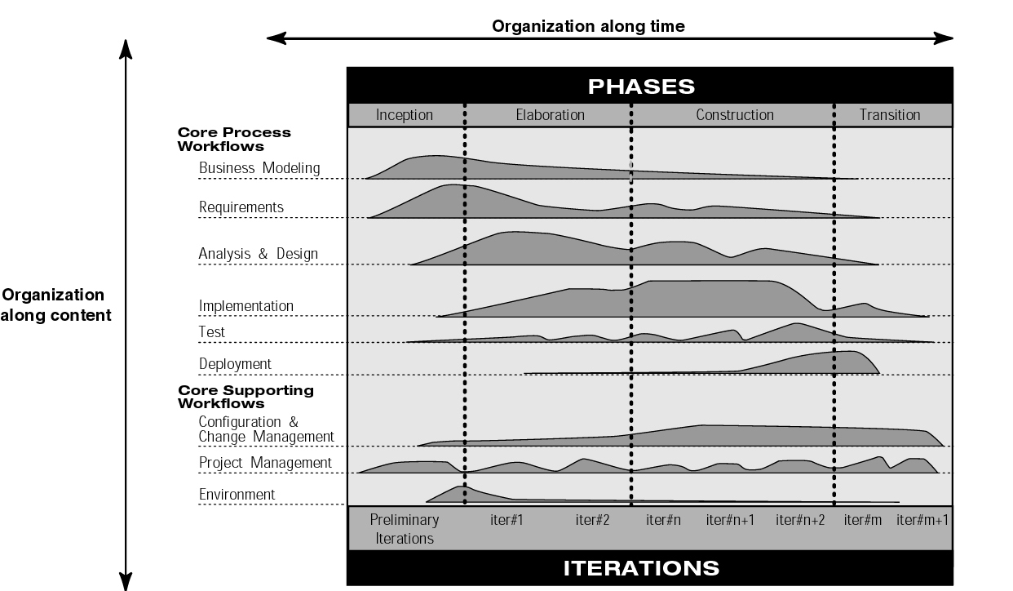
Emphasis changes over iterations
Iterative and Incremental: Rational Unified Process
1998
Source: IBM

Slide 30
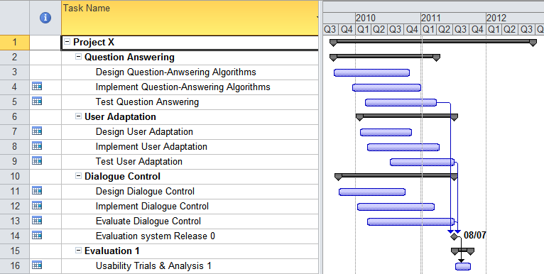
Showing what’s happening and when: The Gantt Chart
Whatever methodology an organisation adopts, planning is important
The Gantt chart, named after Henry Gantt, allows development strands and the relationships between them, to be represented on a timeline
The Gantt chart above, created with Microsoft Project, is intended to represent an iterative development process involving some design, some implementation, some testing, then back to design...

Slide 31
Software Process Maturity
A software development process is mature
if the development activities are well defined and
if management has some control over the quality, budget and schedule of the project
Process maturity is described with
a set of maturity levels and
the associated measurements (metrics) to manage the process
Assumption:
With increasing maturity the risk of project failure decreases

Slide 32
SEI Capability Maturity Level
1. Initial Level
also called ad hoc or chaotic
2. Repeatable Level
Process depends on individuals ("champions")
3. Defined Level
Process is institutionalized (sanctioned by management)
4. Managed Level
Activities are measured and provide feedback for resource allocation (process itself does not change)
5. Optimizing Level
Process allows feedback of information to change process itself

Slide 33
CMM Level 1 – Initial
Capability Maturity Model
Ad hoc approach to software development activities
No problem statement or requirements specification
Inputs and Outputs not defined in advance
Output is expected
but nobody knows how to get there in a deterministic fashion
Similar projects may vary widely in productivity

Slide 34
CMM Level 2 - Repeatable
Inputs and outputs are defined
Input: Problem statement or requirements specification
Output: Source code
Process itself is a black box (activities within process are not known)
No intermediate products are visible
No intermediate deliverables
Project Plan is used and tracked
All deliverables and processes reviewed (QA role)
Configuration Management exists

Slide 35
CMM Level 3 - Defined
Defined software process on all projects
Personnel assigned to improve process (E.g. QA team)
Activities of software development process are well defined with clear entry and exit conditions.
Intermediate products of development are well defined and visible
Peer reviews

Slide 36
CMM Level 4 - Managed
Quantitative Process Management
Productivity and quality metrics defined and constantly measured
Quality Management
Organisation has quality goals and monitors these
Uses information from early project activities to set priorities for later project activities (intra-project feedback)
The feedback determines how and in what order resources are deployed
Effects of changes in one activity can be tracked in the others

Slide 37
CMM Level 5 - Optimised
Measures from software development activities are used to change and improve the current process
This change can affect both the organization and the project:
The organization might change its management scheme
A project may change its process model before completion

Slide 38
Agile Methods
Processes and techniques for incremental and iterative software development with an emphasis on developers, customers and flexibility
Agile Manifesto (2001)
“We are uncovering better ways of developing software by doing it and helping others do it. Through this work we have come to value:
Individuals and interactions over processes and tools
Working software over comprehensive documentation
Customer collaboration over contract negotiation
Responding to change over following a plan”
Valuable
More Valuable

Slide 39
What does the Agile Manifesto Mean?
Individuals and interactions over processes and tools
Adaptive, empowered, self-organising teams
Minimal planning
Continuous Process Refinement
Working software over comprehensive documentation
Iterative and Incremental Approach
Working Software = main metric
All other artefacts minimised
Customer collaboration over contract negotiation
Customers become ‘part of team’
Adaptive, customer relationship
Responding to change over following a plan
Emergent requirements
Frequent inspections

Slide 40
12 Principles of Agile (1)
1. Satisfy customer through early and frequent delivery
2. Welcome changing requirements even late in the project
3. Keep delivery cycles short (2 - 6 weeks)
4. Business people and developers work together daily
5. Build projects around motivated individuals
6. Emphasise face-to-face communication
Notes:
Strong correlation between final quality and frequent deliveries of increasing functionality
Changes viewed as good – the team has learned what it will take to satisfy customer
Software, not documents or plans
Obvious
People who are the team are most important
Less opportunity for ambiguity

Slide 41
12 Principles of Agile (2)
7. Working software is the primary measure of progress
8. Promote sustainable development pace
9. Continuous attention to technical excellence and good design
10. Simplicity (maximise amount of work not done) is essential
11. Best results emerge from self-organising teams
12. Team reflects regularly on improvement (what, when, where, why)
Notes:
7. Not “What phase are we now in” but “30% of software is now working for customer”
8. Don’t borrow tomorrow’s health and energy to get more done today
9. Produce only the highest quality tests and code you can
10. Do what is needed today … and then see if you might break something tomorrow (i.e. test)
11. Responsibilities communicated to the teams as a whole, and team determines best way to fulfil them
12. Obvious

Slide 42
Agile Methods
About 10 “Agile Methods” since mid 90’s
Extreme Programming (XP)
Scrum,
Feature Driven Development
Crystal
DSDM
Rational Unified Process
Lean Software Development
Scrum and Extreme Programming are the best known ones
Scrum emphasises project management
XP emphasises developer activity

Slide 43
What is Extreme Programming?
Things we know from Software Engineering:
Software Eng. Practice | XP Principles
Code Reviews are good | Review code all the time
Testing is good | Everybody tests all the time
Design is good | Part of daily business
Simplicity is good | Always have the simplest design that does the job
Architecture is important | Everybody works in refining architecture
Integration Testing is important | Continuously integrate and test
Short Iterations are good | Make iterations really short
Pair Programming
Unit and functional tests
Refactoring
Simplest Design that works
Use of a metaphor
Continuous Integration
The Planning Game

Slide 44
Extreme Programming (XP)
Taking things to extreme e.g. if inspection is good, do it all the time = pair programming
Sample Practices:
1-3 week iterations
User Stories for collecting requirements
On-site customer
Test Driven Development (XUnit)
Do the simplest thing possible
Refactoring
Coding Standards
Continuous integration

Slide 45
Extreme Programming

Slide 46
Extreme Programming – Main contributions
Small Releases
Small but big enough to give value
Pair Programming
Driver – writes the code
Partner – Thinks about missing tests, integration issues etc
Pairs change frequently
Refactoring
Simplifying/ improving code
Automated tests check behaviour not changed

Slide 47
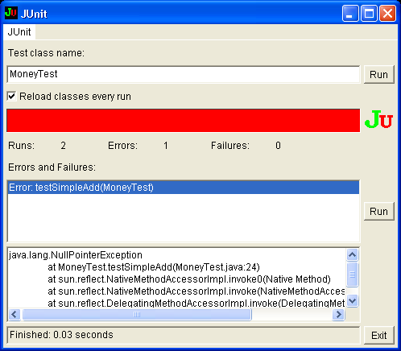
Extreme Programming – Main contributions
Test-Driven Development (or Test First)
Write unit tests first, before the code
“Any program feature without an automated test simply doesn’t exist” - Kent Beck
Use of Unit Testing Tools e.g. Junit (www.junit.org)
Continuous Integration
Integration builds at end of day (or even continuously)

Slide 48
Software Engineering
Chapter 2
Software Process (Life Cycle)
Learning Outcomes
Appreciate the need for a defined software process
Be able to describe in detail the main software process models
Be able to compare software process models and choose between them
Understand software process improvement and maturity
Know about alternative approaches – agile and reengineering
Text: Priestley Chapter One and Chapter Three
Bruegge & Dutoit Chapter Fifteen and Chapter Sixteen

